Slide 1
Theme1 : Algorithmic Pricing
(Grid Dynamics Blog Series)

Slide 2
Part I: The risks and opportunities
Algorithmic pricing is a broad term that generally refers to automated decision-making in the area of price management using rule-based or self-learning algorithms
It is not a pricing strategy, but rather a toolkit for executing a pricing strategy efficiently

Slide 3
Features of Algorithmic Pricing
Dynamic Pricing
Personalization
Differentiated Pricing Strategies
Optimality guarantees
Advanced internal and external signals
Integration with merchandising and inventory management

Slide 4
The impact on Retail : The Home Depot
Firstly , we will analyze the trend graphs for our Monthly duration of regular price changes by retail sector and our Monthly duration of regular and posted price changes
So we would go further and create Year-Month attributes and analyze the above with respect to our product entities table.
The most well known are dynamic pricing and automatic price matching, where the price can change several times a day following competitor prices

Slide 5
Part II: Impact of AI on retail price and promotion management
Pricing strategy can be mapped to intelligent decision-making components
Product lifecycle/ decision making components:
Introductory price optimizer
Profit Optimizer
KVI (key value item) scorer
Promotion optimizer
Competitive response optimizer
Sales event optimizer

Slide 6
Part III: Implementation blueprint
Basic price elasticity analysis-implemented using gradient-boosted decision trees or neural networks (i.e., models with relatively high capacity that can learn complex patterns)
One possible approach is to structure the implementation roadmap around product categories so that models and solvers are developed for one business unit at a time. This approach makes the most sense for department stores that have multiple business units with distinct pricing strategies (e.g., apparel, grocery, home appliances)
Another approach is to structure the program around the capabilities so that top priority functions, such as competitor response, are implemented first

Slide 7
Key Findings
Use Case for Assortment Management :
Forecast demand for new products based on product features and attributes
Use Case for Inventory Management :
Optimize product replenishment decisions based on predicted demand and supply chain constraints

Slide 8
Use Case for Promotion Management :
Forecast demand, revenue, and profit uplift for an individual promotion or group of promotions
Identify promotions that should be halted
Optimize promotion dates and discount values to maximize sales volume, revenue, or profit
Find new promotion opportunities that can boost profits
Determine profit-optimal markdowns for clearance sales given inventory and time constraints
Find optimal customer segments for each targeted promotion campaign
Use Case for Price Management :
Forecast category demand, revenue, and profit for different markup levels or pricing strategies
Optimize profits, revenues, or stock levels by finding optimal pricing parameters
Automatically adjust pricing parameters based on competitor prices and inventory levels
Differentiate prices by store or sales channel

Slide 9
Home Depot can develop such a solution by component based on its business priorities and gradually cover a full range of price management use cases across multiple business units.

Slide 10
THEME 2: CLUSTERING

Slide 11
What is Clustering ?
•Grouping a set of objects in specific groups
•Unsupervised classification

Slide 12
Clustering algorithms
•K-means (partitioned)
•Agglomerative (hierarchical)

Slide 13
K-means clustering algorithm
•‘k’ -> number of clusters that will be created
•‘means’ -> how each data point is joined to a cluster
•Unnested clusters
•Every data point is assigned a single cluster

Slide 14
Steps
•Step 1: Choose “k” points as initial central values (centroids)
•Step 2: Every data point is assigned to cluster having the value closet to centroid
•Step 3: To check whether initial centroids are correct, recompute the centroids
•Step 4: If the recomputed centroids match with original ones, then we are on way of best solution

Slide 15
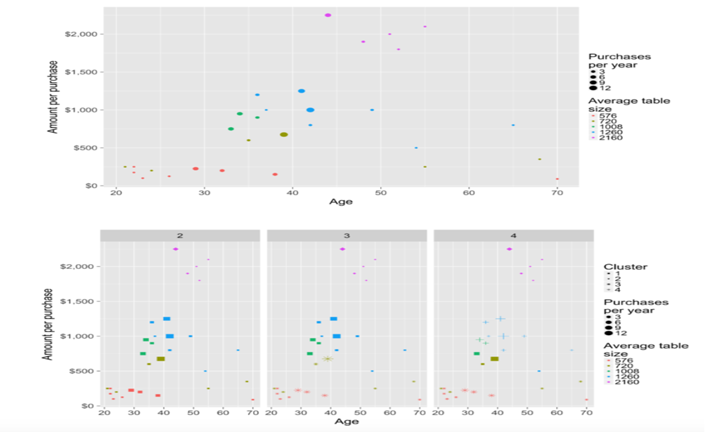

Slide 16
Implementing k-means on HomeDepot dataset
•We Will be implementing k-means algorithm on product sub-category ‘Backpacks’
•Sales of backpacks products will be monitored according to person’s age
•The clusters generated will help us to determine what type of age group take which type of backpack and the revenue generated by it

Slide 17
Agglomerative Hierarchical Clustering
•Algorithm creates cluster by continually nesting data points
•Approaches to hierarchical clustering:
Agglomerative: nests data points by building from bottom up
Divisive Agglomerative: nests data points by building from top down
•It works by merging 2 closest clusters until a single cluster remains
•The final output shows the mapping of how each cluster was merged together in each step

Slide 18
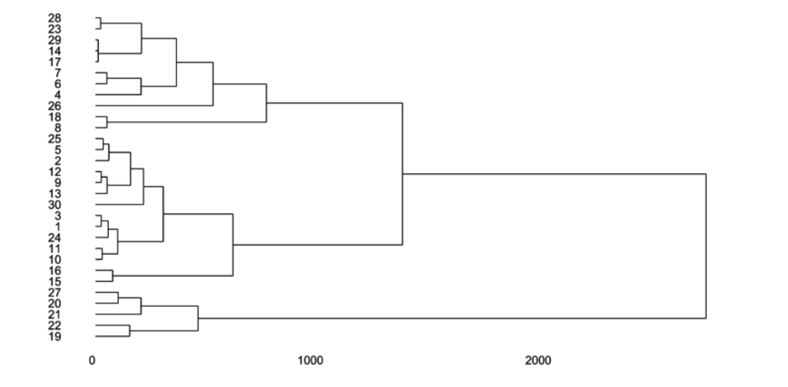

Slide 19
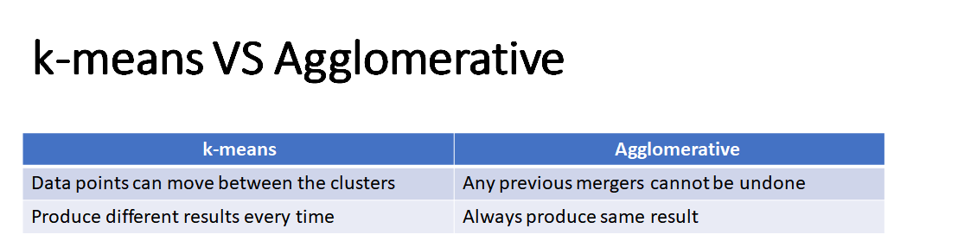

Slide 20
Theme 3: Data Analytics Tools
Outlier-Data Driven Daily Analysis

Slide 21
Major tools
Microsoft Excel
Google Sheets
SPSS
R
-Comparison can be done based on the graphical user interface provided by the tools.
-Excel and Goggle sheets: GUI
-R: programming

Slide 22
How to use the tool?
Conduct a small project using the tool
have a real business deliverable on the line

Slide 23
Excel
Graphical user Interface
Easy and effective comparisons
Powerful charts and dashboards
Working on multiple spreadsheets simultaneously
Functions like mean,avg,median,sum etc are easily applicable
Disadvantages: limited data, not relational, lack of control and security, not suitable for agile

Slide 24
Google Sheets
Free and good for collaboration with other google products
Single version and portable across Oses
Disadvantages: Not much functionality as excel, hard to sport error calculation, Not suitable for Big data

Slide 25
SSPS- Statistical package for social sciences
-created for analysis of social science data
- offers programs like Statistics program, Modeler program, text analysis for survey program, viszulation designer
- A mix between GUI and programming language
- can write reproducible code
Disadvantages: Expensive, Not a full programming language

Slide 26
R
-Data manipulation, statistical modeling, and graphics
- Write software and distribute it in the form of add-on packages.
- Available under open source license and can write testable and reproducible code
Disadvantages: More difficult to get started with compared to other tools

Slide 27
Home depot data
Data platform consist of product hierarchy, customer data, sales for products, marketing ways and promotion
Excel can be used to analyze to get mid-level business insights like the aggregate values
Pivot tables and charts can be made based on product data
R can be used to cluster the data to get customer segmentation

